Slide 2
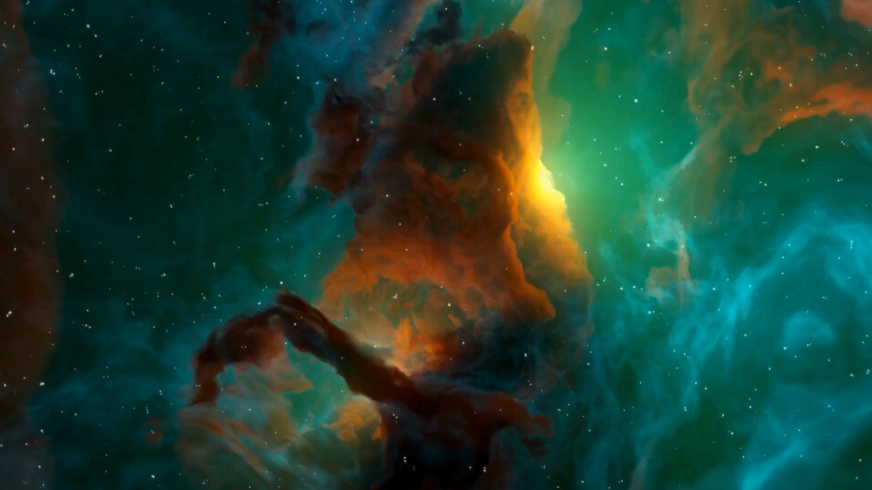

Slide 3
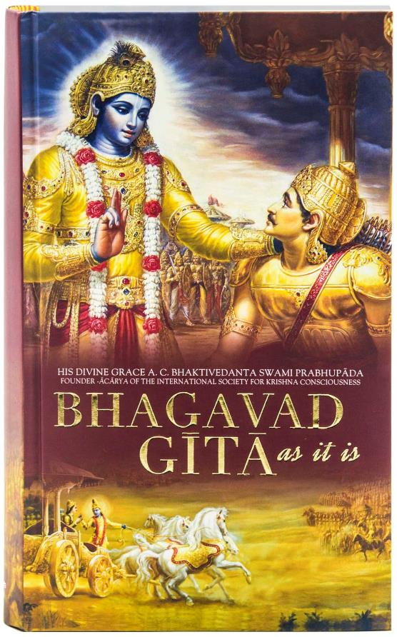
BhagavadGita
Presented By:
Vidhya Battula

Slide 4
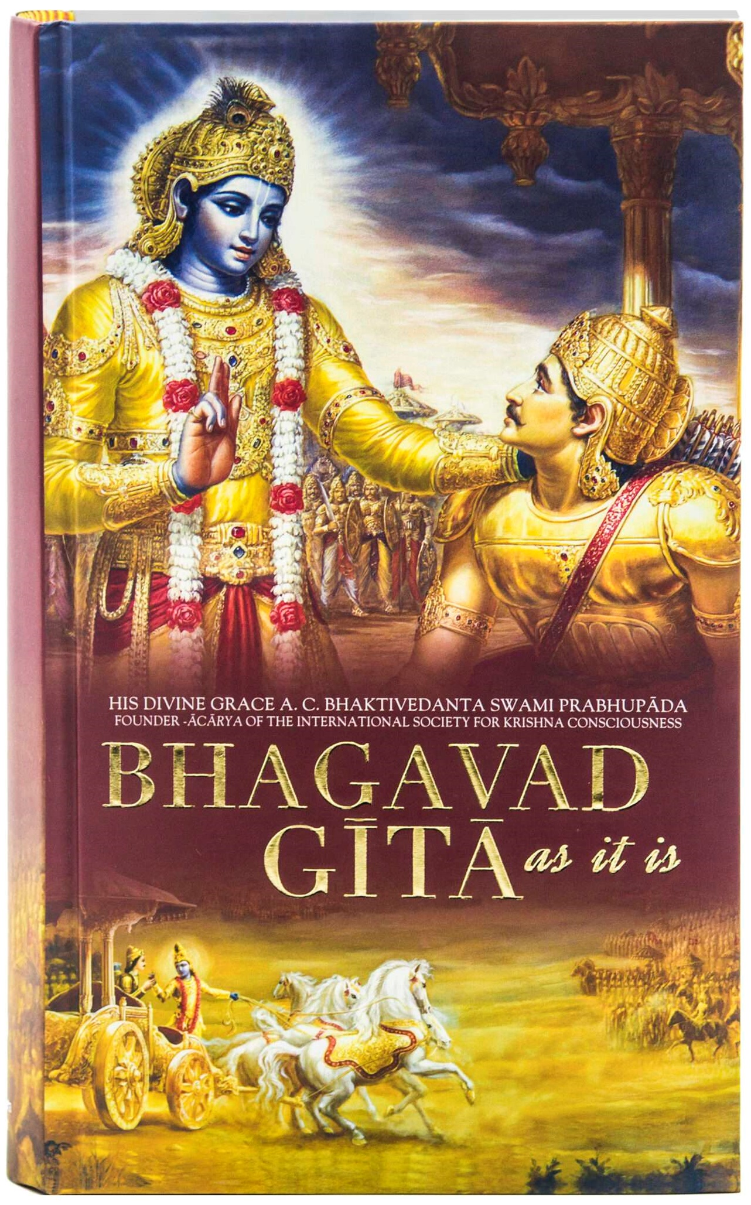
What is BhagavadGita?
Notes:
This book was written in the context of the battlefield of Kurukshetra, where, a great war was about to begin, between 2 brothers for the throne. The Gita is Krishna's counsel to Arjuna on his duties as a warrior, emphasizing the importance of following one's dharma.
This book talks about Dharma, showing a path of how to live life in a righteous way, and it also tells us how to connect to consciousness from within. This is why it matters to me.

Slide 5

Results of Topic Modeling
Topic 1 Top Words:
Highest Prob: knowledge, yoga, attain, sacrifice, brahman, supreme, worship
FREX: knowledge, yoga, brahman, worship, practice, faith, offer
Lift: darkness, element, faith, fix, happiness, ignorance, offer
Score: knowledge, sacrifice, brahman, yoga, attain, austerity, offer
Topic 4 Top Words:
Highest Prob: sense, body, free, attachment, declare, perform, object
FREX: sense, free, attachment, declare, call, sin, wisdom
Lift: attachment, declare, absolute, accord, age, attainment, aversion
Score: free, attachment, act, sense, perform, family, abandon
Topic 2 Top Words:
Highest Prob: action, mind, good, nature, man, bear, control
FREX: action, nature, duty, fruit, renunciation, pure, sattvic
Lift: abandonment, absence, accept, action, arch, attach, balance
Score: action, nature, duty, mind, good, fruit, bear
Topic 5 Top Words:
Highest Prob: world, lord, thou, god, great, form, bless
FREX: form, divine, sage, obtain, fear, move, devotion
Lift: art, existence, fear, find, mouth, move, obtain
Score: form, unmoving, great, mouth, lord, universe, eye
Topic 3 Top Words:
Highest Prob: arjuna, desire, krishna, son, end, pleasure, eternal
FREX: son, pleasure, arm, mighty, battle, slay, fight
Lift: arm, array, chariot, enemy, kill, mighty, passionate
Score: son, arjuna, stand, battle, desire, krishna, dhritarashtra

Slide 6
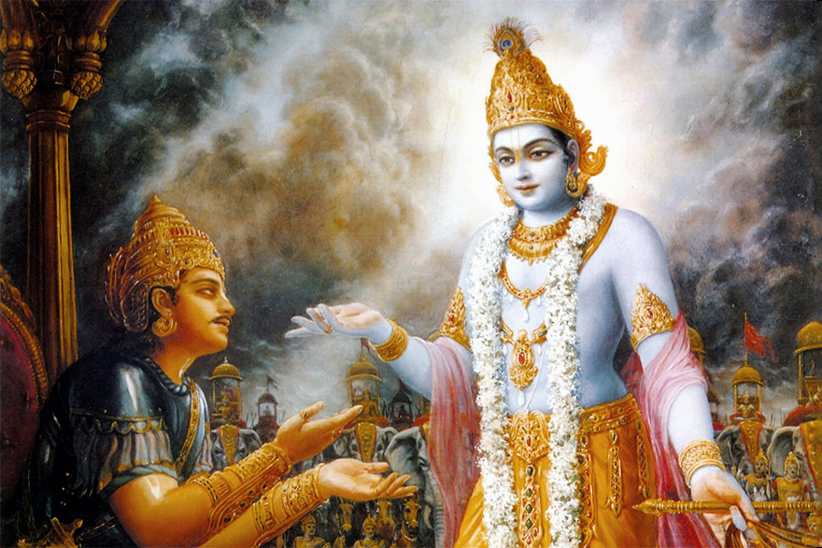
Topics:
1. Spiritual Practice and Knowledge
2. Ethics and Duty
3. The Warrior's Dilemma
4. Liberation and Detachment
5. Divine Manifestation and Devotion
Notes:
It emphasizes yoga, worship, and sacrifice as means to understand and connect with the supreme Brahman.
It deals with the nature of duty, the importance of renunciation, and performing actions without attachment to the fruits.
As I told before, this topic talks about the dilemma of Arjuna whether to battle with his brothers.
This topic explores the path to liberation through detachment from the senses and material objects, acting without personal desire, and the importance of wisdom and discernment in achieving freedom.
This topic references to Lord Krishna's cosmic form. You want to take a look at The Cosmic Form? And let’s see what a popular person says about the cosmic form.

Slide 7

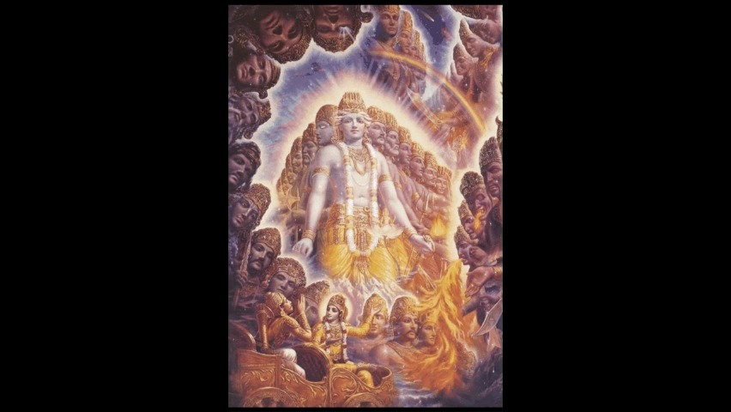

Slide 8
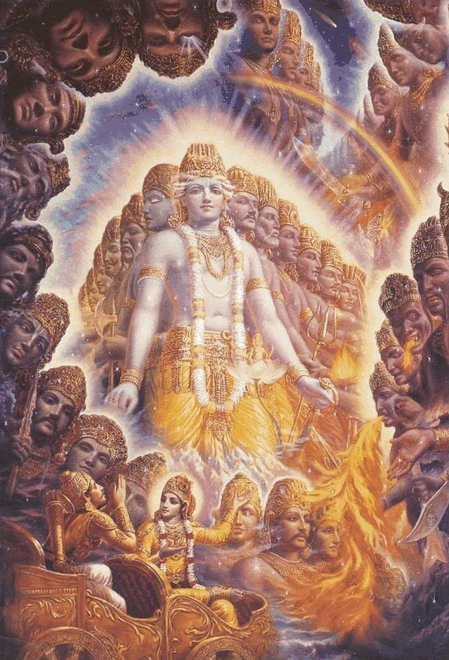
Object Detection
Objects | Confidence
Brain coral | 0.826137
Coral reef | 0.043541
Sea slug | 0.031217
jellyfish | 0.025196
honeycomb | 0.020588
Hen of the woods | 0.013664
Sea urchin | 0.012808
loggerhead | 0.005753
starfish | 0.003169
velvet | 0.002517
Notes:
Let me tell you something funny, this is the image I’ve uploaded and trained on YOLO model and see what it predicted. Coral, Sea slug and starfish? Seriously? Maybe this model is trained more on marine animals. Last but not the least

Slide 9
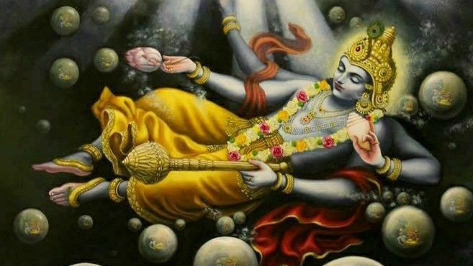
Notes:
He is the Supreme God of Hinduism and he says

Slide 10
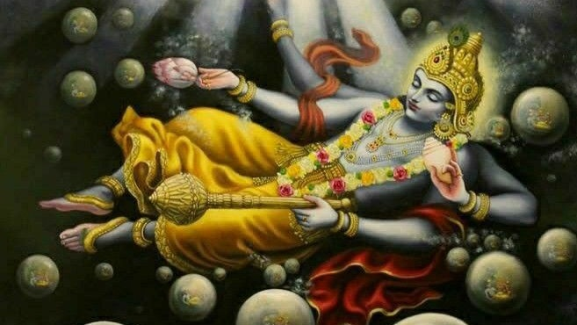
“I’m everything and everything is in me”
Notes:
He says, “I’m everything and everything is in me”. The statement encourages individuals to look beyond their ego and physical identity to recognize their true self (Atman) as part of the universal essence (Brahman).

Slide 11
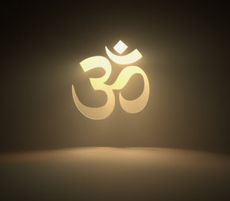
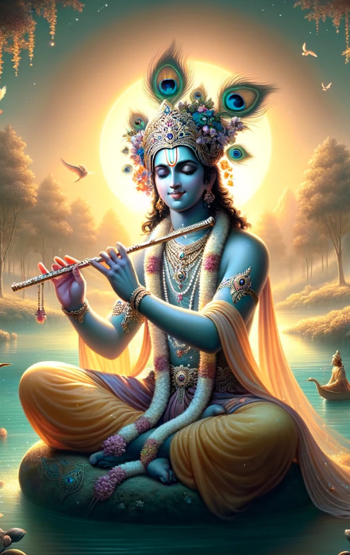
Follow
DHARMA

Slide 12
You
Thank

Slide 13
Appendix

Slide 14

Topic 1: Spiritual Practice and Knowledge
Topic 1 Top Words:
Highest Prob: knowledge, yoga, attain, sacrifice, brahman, supreme, worship
FREX: knowledge, yoga, brahman, worship, practice, faith, offer
Lift: darkness, element, faith, fix, happiness, ignorance, offer
Score: knowledge, sacrifice, brahman, yoga, attain, austerity, offer
This topic is centered on the spiritual practices that lead to knowledge and enlightenment in the Bhagavad Gita.
It emphasizes yoga, worship, and sacrifice as means to understand and connect with the supreme Brahman.

Slide 15
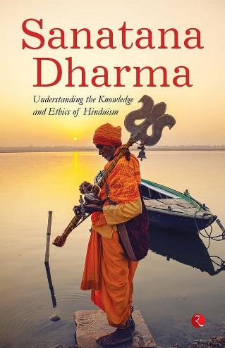
Topic 2: Ethics and Duty
Topic 2 Top Words:
Highest Prob: action, mind, good, nature, man, bear, control
FREX: action, nature, duty, fruit, renunciation, pure, sattvic
Lift: abandonment, absence, accept, action, arch, attach, balance
Score: action, nature, duty, mind, good, fruit, bear
This topic pertains to the moral and ethical actions prescribed in the Gita.
It deals with the nature of duty, the importance of renunciation, and performing actions without attachment to the fruits.

Slide 16
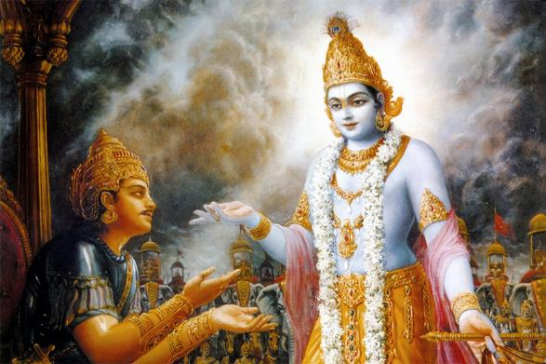
Topic 3: The Warrior's Dilemma
Topic 3 Top Words:
Highest Prob: arjuna, desire, krishna, son, end, pleasure, eternal
FREX: son, pleasure, arm, mighty, battle, slay, fight
Lift: arm, array, chariot, enemy, kill, mighty, passionate
Score: son, arjuna, stand, battle, desire, krishna, dhritarashtra
Arjuna's conflict and desires are central here, along with Krishna's counsel.
It includes themes of war, duty, familial ties, and the eternal nature of the soul.

Slide 17
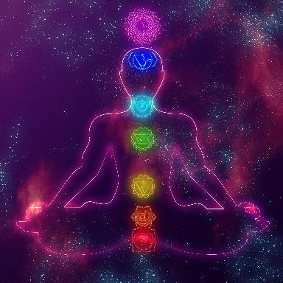
Topic 4: Liberation and Detachment
Topic 4 Top Words:
Highest Prob: sense, body, free, attachment, declare, perform, object
FREX: sense, free, attachment, declare, call, sin, wisdom
Lift: attachment, declare, absolute, accord, age, attainment, aversion
Score: free, attachment, act, sense, perform, family, abandon
This topic explores the path to liberation through detachment from the senses and material objects, acting without personal desire, and the importance of wisdom and discernment in achieving freedom.

Slide 18
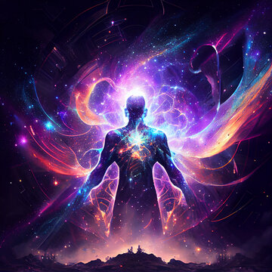
Topic 5: Divine Manifestation and Devotion
Topic 5 Top Words:
Highest Prob: world, lord, thou, god, great, form, bless
FREX: form, divine, sage, obtain, fear, move, devotion
Lift: art, existence, fear, find, mouth, move, obtain
Score: form, unmoving, great, mouth, lord, universe, eye
It discusses the various forms and greatness of the divine, emphasizing the importance of devotion and the perception of God in the world.
It includes references to Lord Krishna's cosmic form.

